Slide 1
2023 Summer Intern Final Presentation
Communication & Signal Processing Lab
SEOKCHAN KANG, SEUNGHYUN KIM, JONGHO JANG

Slide 2
What we did
Investigated the current status of V2X Access Technologies
Conducted BER & SER Analyses for MPSK (BPSK and QPSK) Schemes using Matlab
Explored the fundamentals of LTE technology
Conducted Object Detection with YOLOV7

Slide 3
DSRC & C-V2X
 | DSRC | C-V2X
Latency | low(might be increased under sub-optimal conditions) | high
Reliability | low | high(due to its repetitive transmission)
Coverage | LOS+short communication condition call for better coverage | might be inconsistent in mountainous and rural areas
Security | vulnerable(due to its ad-hoc nature) | robust(due to its centralized infrastructure)
Privacy | Safe due to temporary pseudonymous certificates | cellular communications with a subscriber ID imposes a potential risk
Cost | absence of infrastructure implies significant costs | low infrastructural cost, but costs occur from high mobile data rates

Slide 4
Information Types
Category | Use Case Examples | Latency | Throughput | Communication - Freq
Infotainment | Netflix, Music | 500~1000 ms | 80 Mbps | 1 Hz
Traffic Efficiency | Navigation | 100~500 ms | 10~45 Mbps | 1 Hz
Traffic Safety | Pre-sense crash warning | 20~100 ms | 0.5~700 Mbps | 10 Hz
Cooperative Driving | Cooperative Adaptive - Cruise Control | 2~10 ms | 5 Mbps | 10 Hz

Slide 5
V2X Message Types
 | CAM | BSM
Similarity | -Use fixed, predefined frequency to broadcast message -Contains general information(heading, speed and position of car) -Exploits congestion control algorithms based on Channel Busy Ratio(CBR)
Organization | European Union | SAE (USA)
Frequency | 1Hz | 10Hz
Congestion Control | Decentralized Congestion Control | LIMERIC
Urgent Message | Decentralized Environmental Notification Message(DENM) | BSM Part 2

Slide 6
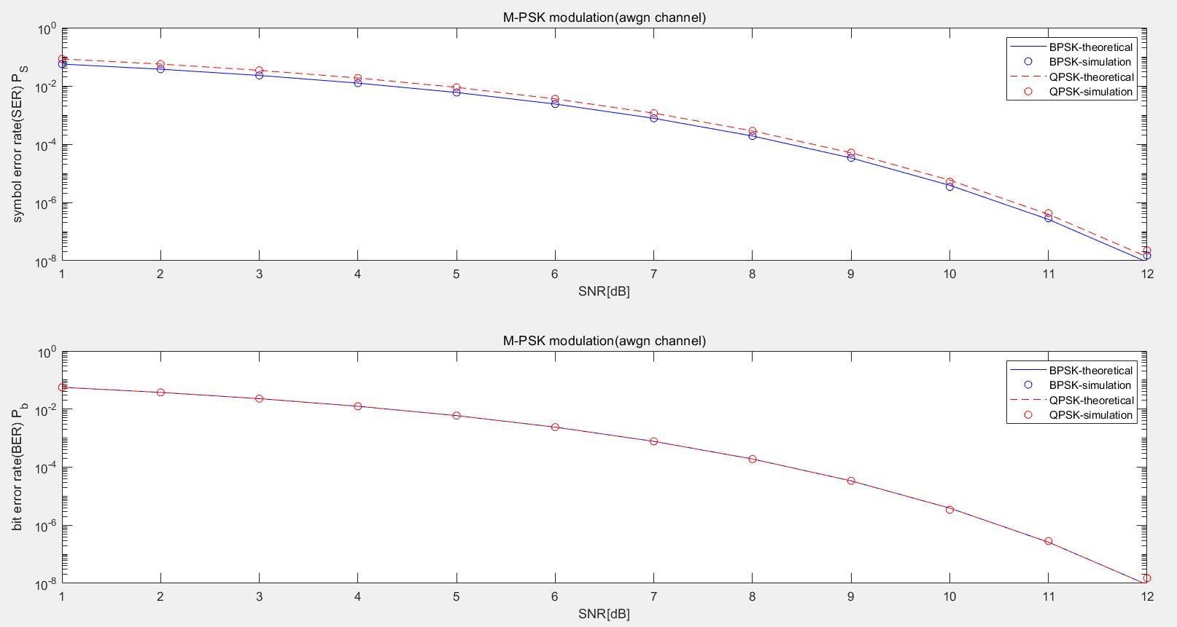
MPSK MATLAB simulation

Slide 7
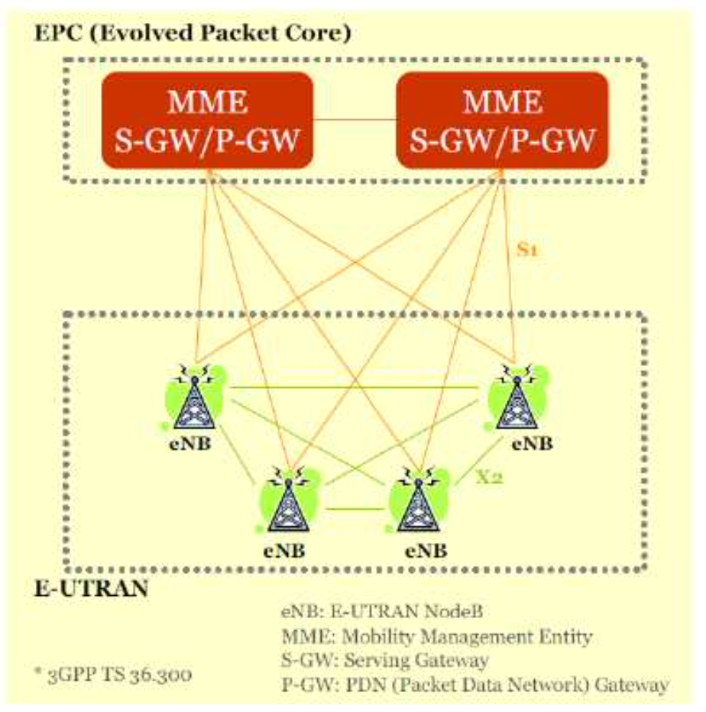
LTE Network Architecture
MME: Handles control-related functions, including connection establishment and release, as well as security key management.
S-GW: Involved in mobility between handovers or various 3GPP technologies, and performs information collection for billing purposes.
P-GW: Manages internet connectivity, assigns IP addresses, and applies Quality of Service (QoS) policies.
PCRF: Manages QoS and billing.
HSS: Manages user information.
E-UTRAN : Evolved Universal Terrestrial Radio Access Network
Optimized for PS domain (VoIP), no more CS domain(3G)

Slide 8
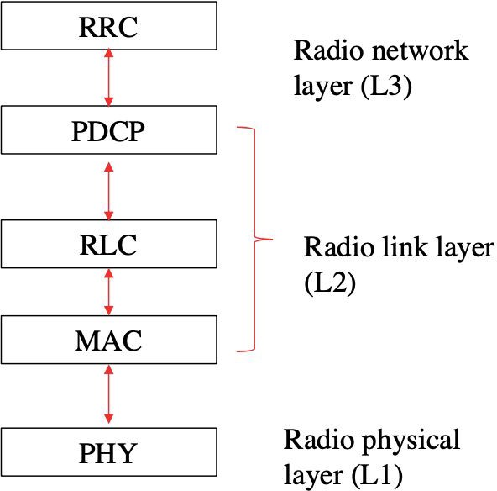
Wireless Protocol Structure
RRC: Responsible for establishing and maintaining the connection between the terminal device and the eNB (Evolved NodeB). It also plays a role in handovers when the terminal device moves.
PDCP: Utilizes ROHC (Robust Header Compression) algorithms to compress IP headers, encrypt data, and ensure data integrity.
RLC: Manages segmentation and retransmission and ensures that data is transmitted in the correct order for upper-layer protocols.
MAC: Handles HARQ (Hybrid Automatic Repeat Request) retransmissions and scheduling. There is one MAC entity per cell.
PHY: Involved in coding, modulation, and multiplexing processes.

Slide 9
Wireless Protocol Structure
RRC: Responsible for establishing and maintaining the connection between the terminal device and the eNB (Evolved NodeB). It also plays a role in handovers when the terminal device moves.
PDCP: Utilizes ROHC (Robust Header Compression) algorithms to compress IP headers, encrypt data, and ensure data integrity.
RLC: Manages segmentation and retransmission and ensures that data is transmitted in the correct order for upper-layer protocols.
MAC: Handles HARQ (Hybrid Automatic Repeat Request) retransmissions and scheduling. There is one MAC entity per cell.
PHY: Involved in coding, modulation, and multiplexing processes.

Slide 10
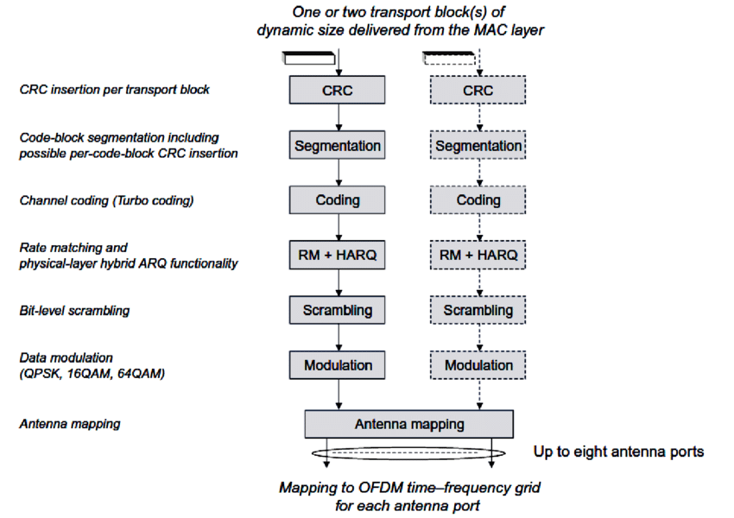
Physical Layer Processing(1)
010110..
Channel Coding, Scramble, Modulation,..

Slide 11
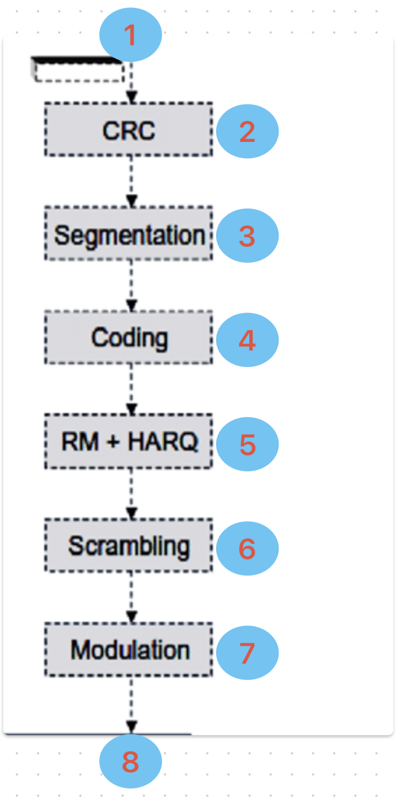
Physical Layer Processing(2)
Input: Transport Block received from the MAC layer
CRC: Attach a 24-bit CRC to the Transport Block
Segmentation: If larger than 6144 bits, divide it into multiple code blocks with per-code-block CRC insertion
Channel Coding: Utilize Turbo Coding for forward error correction, adding extra bits to aid in error detection and correction at the receiving end
Rate Matching/HARQ: Combine and split code blocks to create one output bitstream to match the desired Data Rate
Scrambling: Achieve a balanced ratio of 0s and 1s through XOR operations to enhance interference resilience and assist in error detection
Modulation: Depending on the modulation scheme, map bits to symbols for data modulation (QPSK, 16QAM, 64QAM)
Antenna Mapping: Take the symbols mentioned above, allocate them to a resource grid, and transmit them on a wireless channel.

Slide 12
Yolov7
Enter the Conda virtual environment after installing Anaconda.
Download the Yolov7 package and install the requirements.
Train on a pre-obtained dataset of 60,000 images to obtain weights.
Perform object detection.
Calculate the mAP (mean average precision) score using the results from step 4.
Vary the original image resolution from 320x180 to 1280x720 and repeat steps 4 and 5.
(mAP: Mean Average Precision)

Slide 13
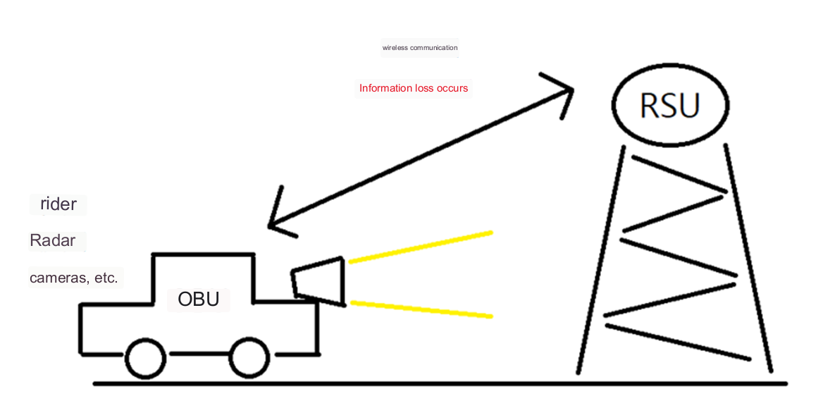
Goal
Wireless communication between OBU and RSU experiences information loss. Therefore, we investigate the difference in object recognition performance based on the performance of the communication channel and image quality.

Slide 14
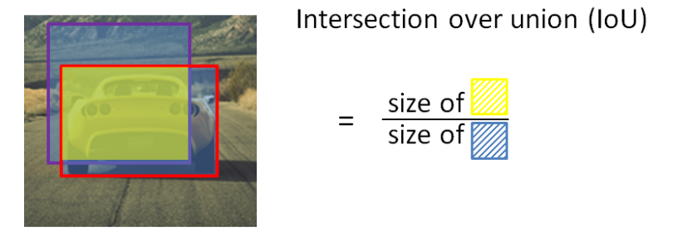
IoU(Intersection Over Union)
A metric for evaluating the accuracy of object detection.
It represents whether the detection of objects was successful as a value between 0 and 1.

Slide 15
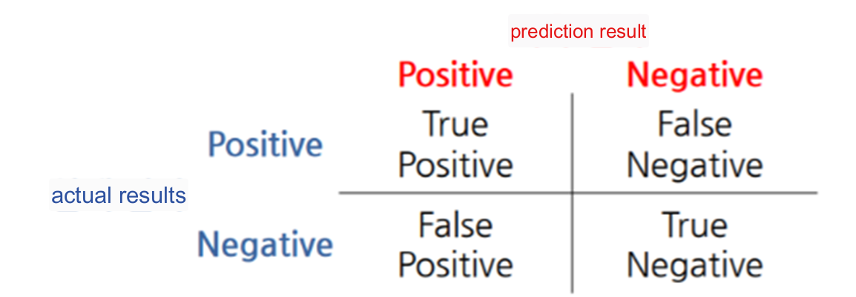
Confusion Matrix
TP: Objects correctly detected with IoU above the threshold. (usually 0.5 or 0.75)
FP: Objects incorrectly detected with IoU below the threshold.
TN: Typically not used in object detection.
FN: Objects missed in detection with IoU below the threshold.

Slide 16
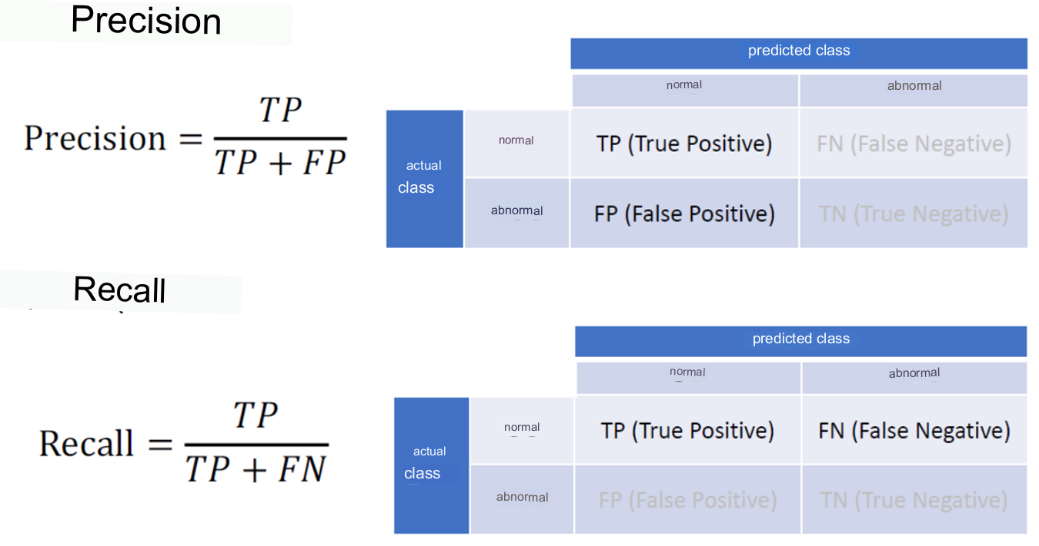
Precision & Recall

Slide 17
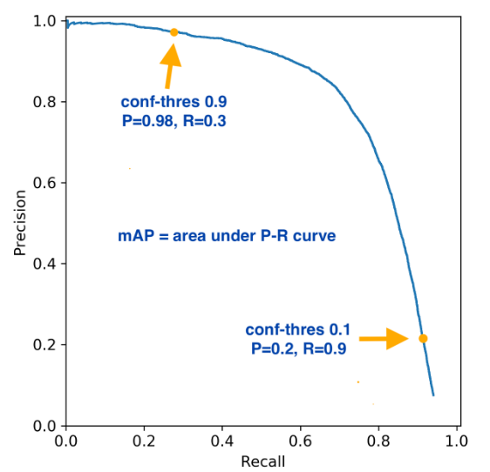
PR-Curve
mAP score is the area under P-R curve

Slide 18
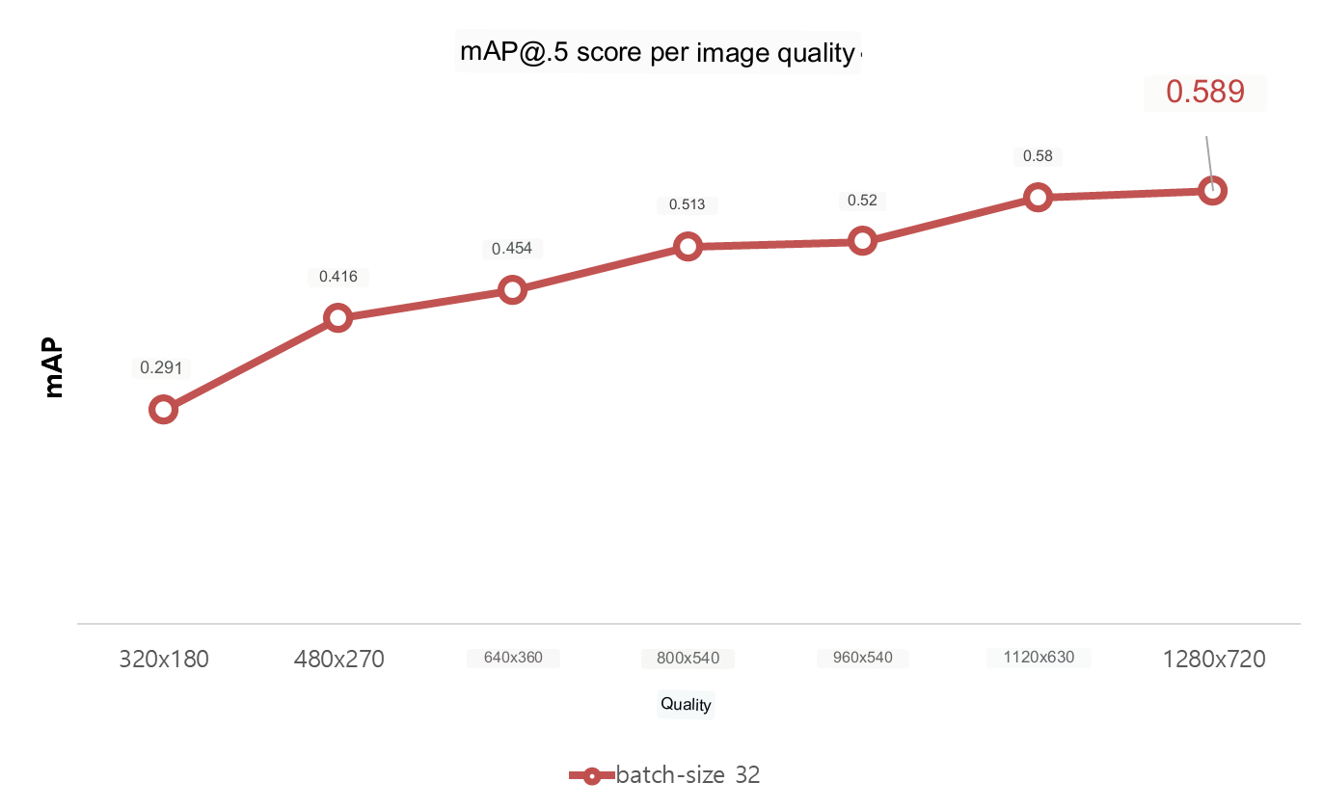
LOS Result

Slide 19
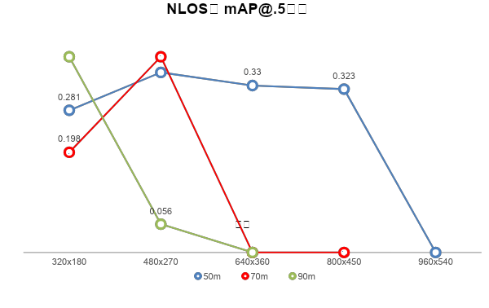
NLOS Result

Slide 20
Methods for improving mAP values
Add image data
For classes with low mAP values, add images and retrain the model.
This process requires a substantial number of images and the creation of corresponding labels by humans, which is a drawback.
Adjust hyperparameters
Modify hyperparameters such as batch size, iteration, learning rate, and epochs during the model training process.

Slide 21
Conclusion
 | Resolution | mAP
LOS (ideal communication) | 1280x720 | 0.589
50m | 480x270 | 0.356
70m | 480x270 | 0.387
90m | 320x180 | 0.387
In ideal communication conditions (Line of Sight - LOS), there was a tendency that better image quality led to improved object recognition performance.
However, under poor communication conditions, higher image quality did not guarantee better object recognition performance.

